Slide 1

Compound Interest and
Simple Interest

Slide 2
Principal
The money borrowed for a certain period is called the principal or the sum.
Interest
Extra money paid for using other's money is called interest.
Simple Interest
If the interest on a sum borrowed for certain period is reckoned uniformly, then it is called simple interest.

Slide 3
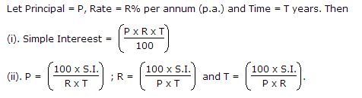

Slide 4

Q1) What annual payment can clear a debt of Rs. 4600 due in 4 years . The S.I. rate being 10% per annum.
5860
6200
6440
6520

Slide 5


Q2) A man took loan from a bank at the rate of 12% p.a. simple interest. After 3 years he had to pay Rs. 5400 interest only for the period. The principal amount borrowed by him was:
2000
10000
15000
20000

Slide 6

Q3) Priya borrowed some money at the rate of 6% per annum for the first 3yr, at the rate of 9% per annum for the next 5yr and at the rate of 13% per annum for the period beyond 8yr. If she pays a total interest of Rs. 8160 at the end of 11yr. how much money did she borrow?
12000
10000
8000
None of these

Slide 7

Q4) How much time will it take for a sum of Rs. 450 to yield Rs. 81 as interest at 4.5% per annum of simple interest?
3.5 yrs
4 yrs
4.5 yrs
5 yrs

Slide 8

Q5)A sum of money invested for a certain number of years at 8% p.a. simple interest grows to Rs.180. The same sum of money invested for the same number of years at 4% p.a. simple interest grows to Rs.120 only. For how many years was the sum invested?
20
15
25
22

Slide 9
Compound Interest
Compound interest is the interest earned not only on the original principal, but also on all interests earned previously

Slide 10
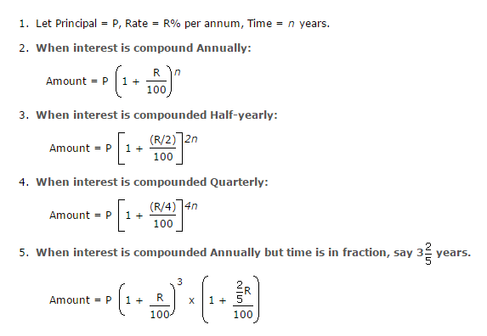
Important Formulae:

Slide 11
Q1. What is the difference between the compound interests on Rs. 5000 for 1 years at 4% per annum compounded yearly and half-yearly?
Rs 2
Rs 3
Rs 4
None of these

Slide 12
Q2. Find S.I. on Rs 400 for 8 months at 9/2% p.a. Also, find the amount ?
Rs 415.75
Rs 412.75
Rs 417.50
Rs 418.95
None

Slide 13

Q3. The compound interest on Rs. 30,000 at 7% per annum is Rs. 4347. The period (in years) is:
5
4
3
2

Slide 14
Q4. A sum of money placed at C.I. doubles itself 4 yrs. In how many years will it amount to eight times itself.
a) 12 years
b) 16 years
c) 20 years
d) 24 years

Slide 15
Q5. Determine the rate of interest for a sum that becomes 216/125 times of itself in 3 years compound annually.
10%
20%
25%
30%

Slide 16

Q6. If Rs. 500 amounts to Rs. 583.20 in two years compounded annually, find the rate of interest per annum?
6%
7%
8%
9%

Slide 17

Q7. What will be the compound interest on a sum of Rs. 25,000 after 2 years at the rate of 12 % p.a.?
6000
8720
6360
7830

Slide 18

Difference of SI and CI
For 2 yr:
P(sum)= difference * (100/r)²
For 3 yr:
P(sum)=

Slide 19

Q8. The difference between simple and compound interests compounded annually on a certain sum of money for 2 years at 4% per annum is Re. 1. The sum (in Rs.) is:
630
625
650
None of these

Slide 20

Q9. A sum of rupees 10000 becomes 14400 compounded annually with rate of interest 20%. Find the number of years?
1 yrs
2 yrs
3 yrs
4 yrs

Slide 21
Q10. There is 60% increase in an amount in 6 years at simple interest. What will be the compound interest of Rs. 12,000 after 3 years at the same rate?
3960
3972
3860
3960

Slide 22


